Slide 1
Algorithmic Trading
Ewan Cook

Slide 2
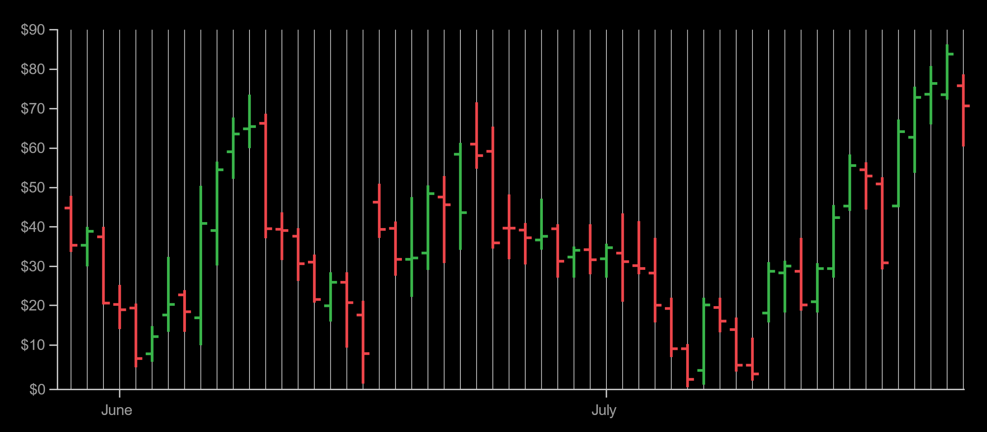
Algorithmic Trading…?
The process of using computers programmed to follow a set of ‘rules’ for placing a trade
Rules:
Price
Volatility
Trends (Momentum)
Advanced Models (sentiment analysis etc.)

Slide 3
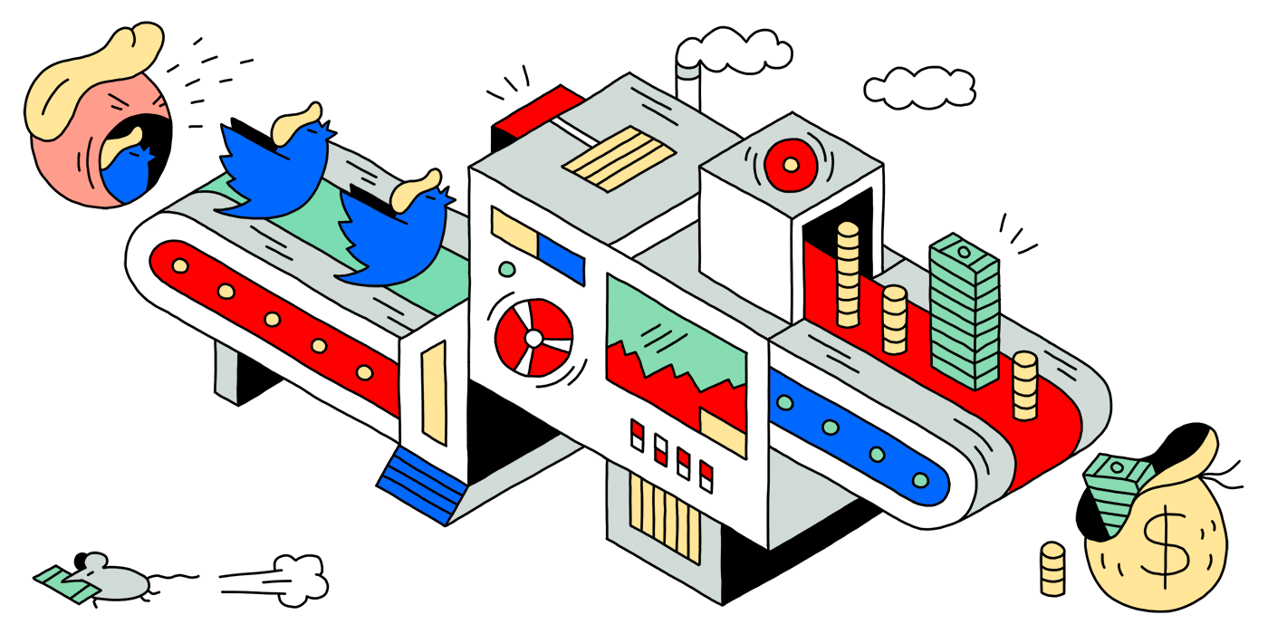
Sentiment Analysis (trump2cash)

Slide 4
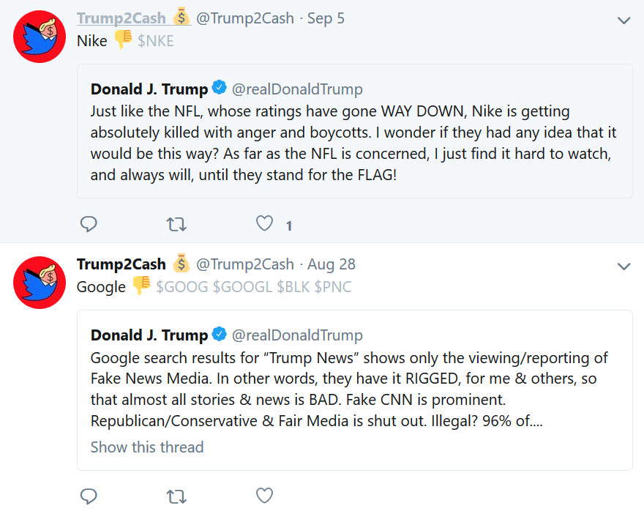
Sentiment Analysis (trump2cash)

Slide 5
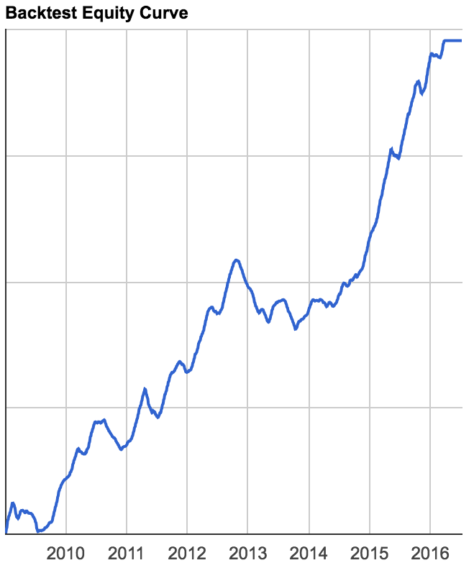
Advantages – Fast, Accurate
‘Instantaneous’ trade execution
Efficient multi-exchange trading
Reduced risk (in some areas)
Ability to operate indefinitely
Multiple strategies
Ability to backtest
Little human bias!

Slide 6



Disadvantages - Pointless trying?
Initial Costs: Time, Money
Maintenance
Model Reliability
Too reliant on backtesting?
HFT is the competition
No chance against HFT companies

Slide 7
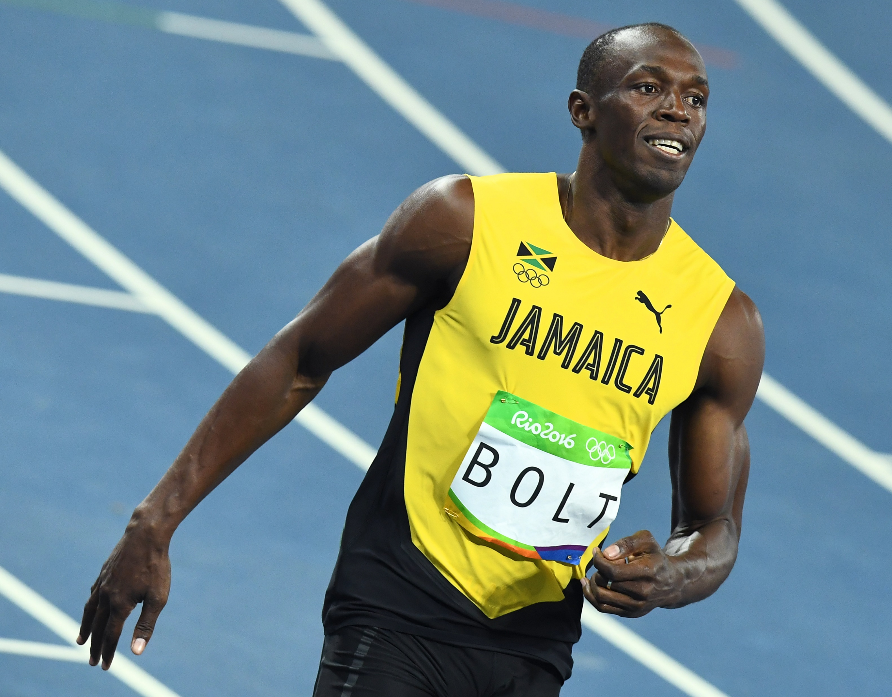
High Frequency Trading (HFT)
165,000 trades in the time it takes Usain Bolt to react to the starting pistol!

Slide 8
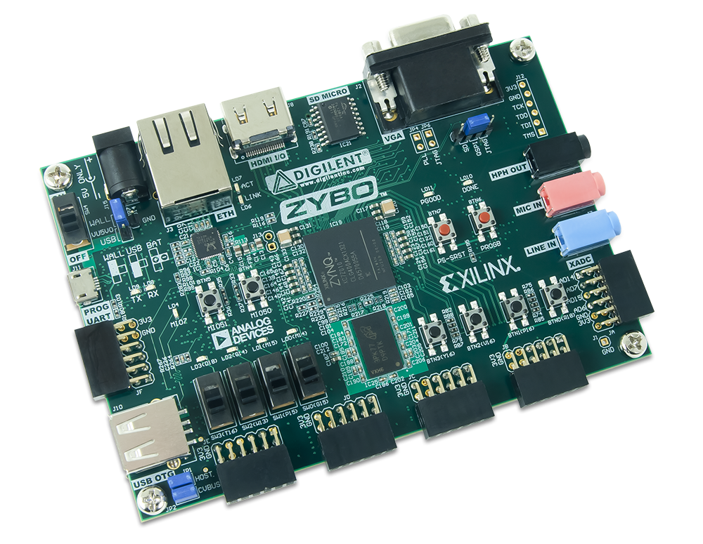
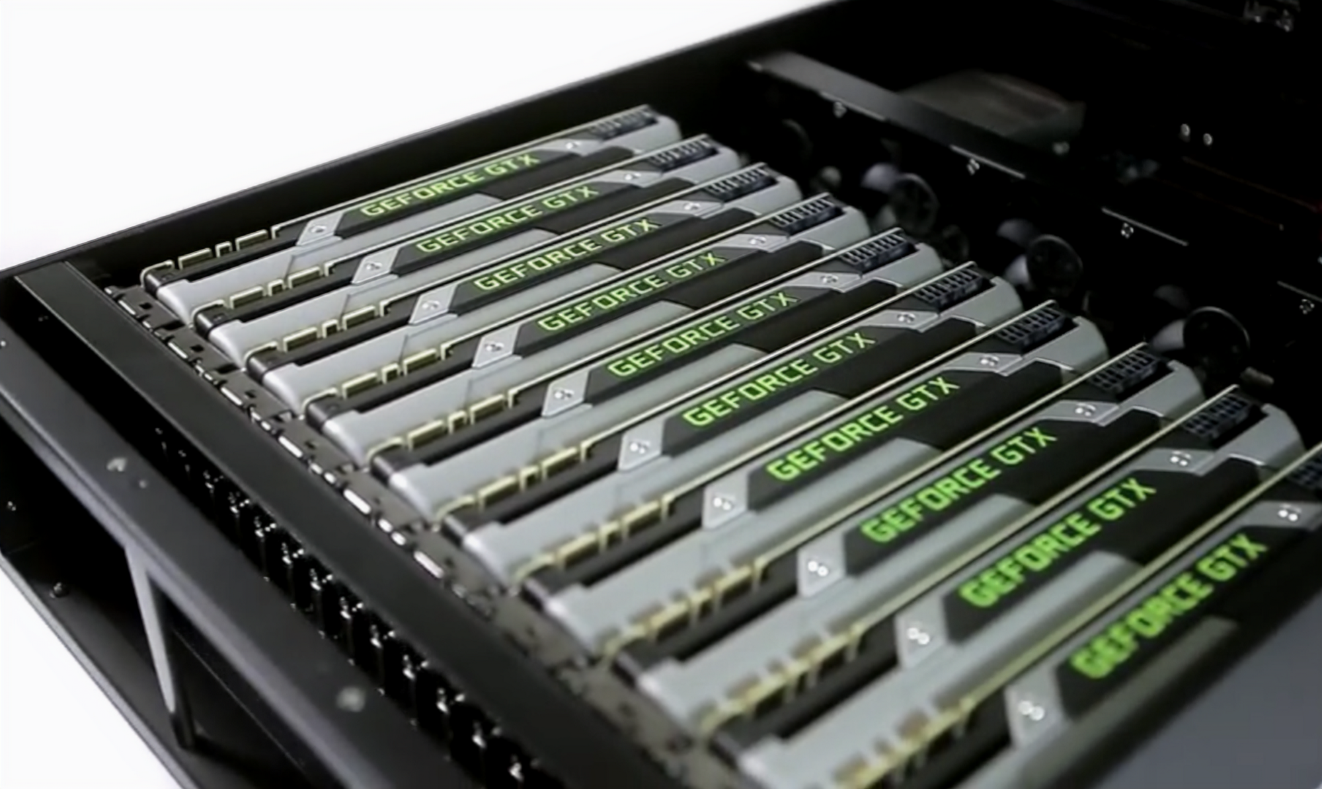
HFT Hardware
Servers co-located in the racks next to matching servers
FPGAs for data processing and trade execution
GPUs for parallel analysis
Sub-microsecond switch latency

Slide 9
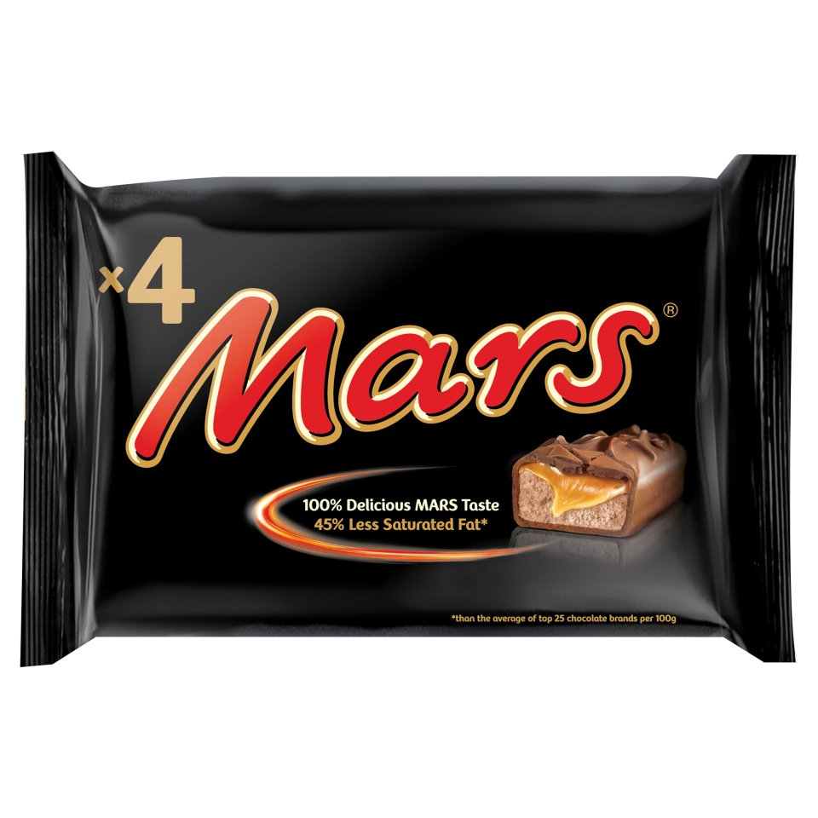

Arbitrage – An Example ‘Algorithm’
“Profiting from differences in prices in different markets”
Buy in Tesco for £1
Sell at school for 50p each

Slide 10
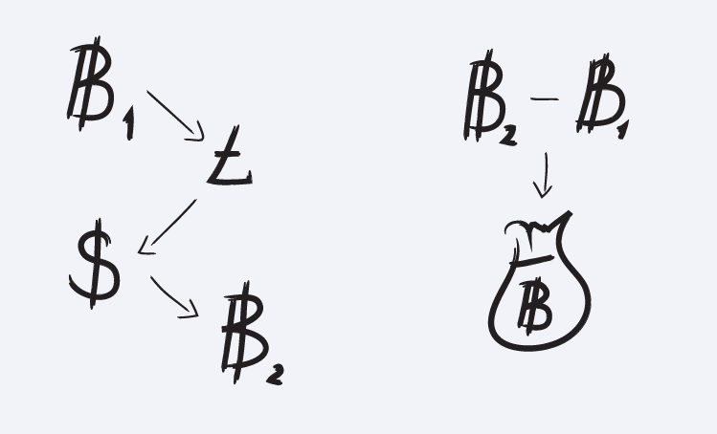
Triangular Arbitrage

Slide 11
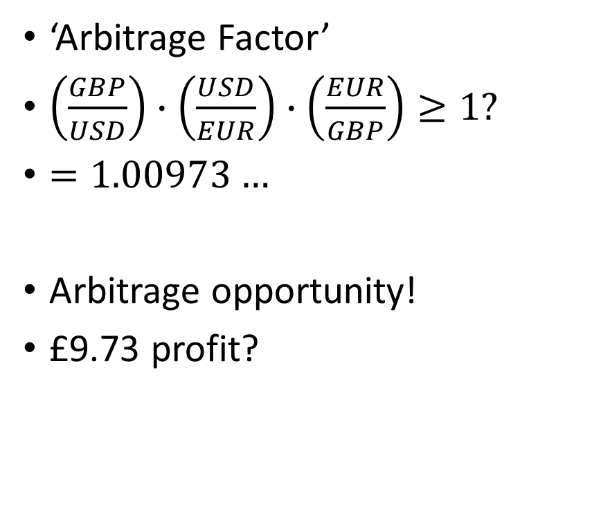
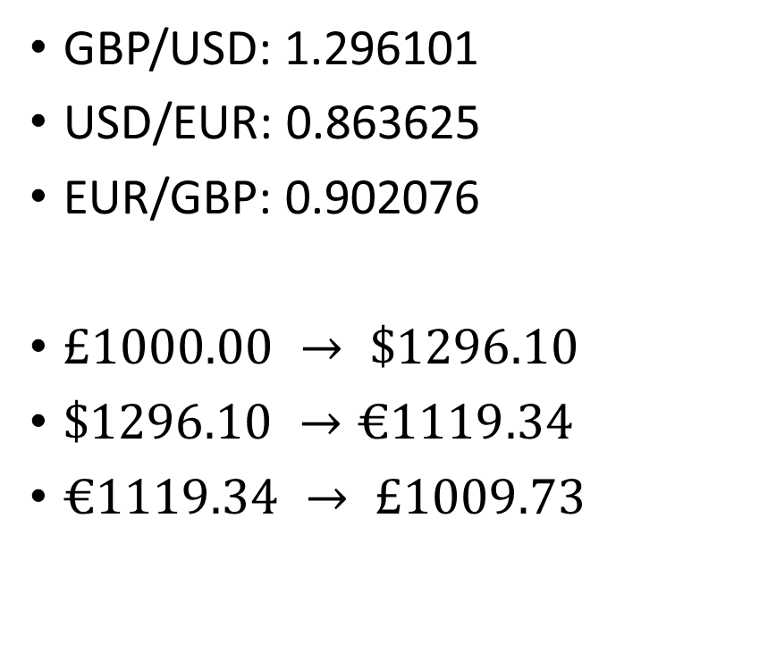
Triangular Arbitrage
GBP/USD: 1.296101
USD/EUR: 0.863625
EUR/GBP: 0.902076
$£1000.00 → \$1296.10$
$\$1296.10 →€1119.34$
$€1119.34 → £1009.73$
‘Arbitrage Factor’
$\left(\frac{GBP}{USD}\right)∙\left(\frac{USD}{EUR}\right)∙\left(\frac{EUR}{GBP}\right)≥1?$
$=1.00973…$
Arbitrage opportunity!
£9.73 profit?

Slide 12
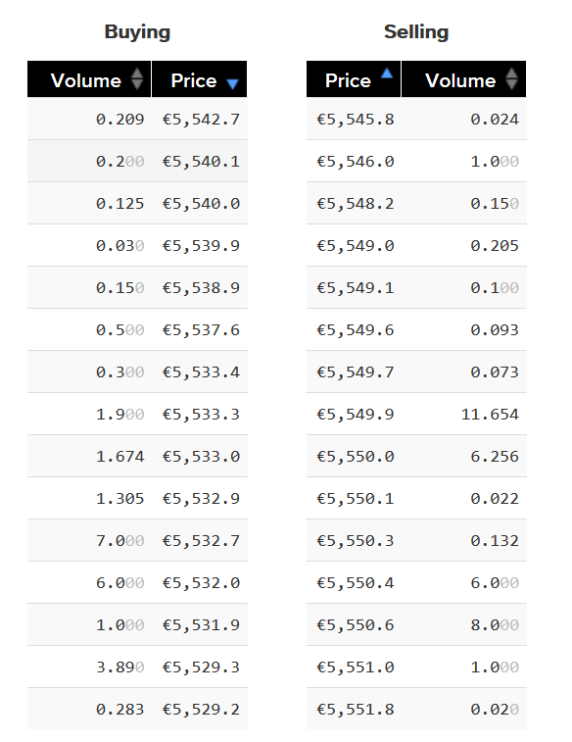
DIY Algorithmic Trading?
Arguably pointless on FOREX markets, stock exchanges
Viable on Cryptocurrency markets!
Still liquid
Larger fluctuations
No HFT competition
Lots of accessible exchanges
Buy/Sell spread varies largely inter-exchange
Cloud trading (QuantConnect etc.)
Open Source algo trading platforms

Slide 13
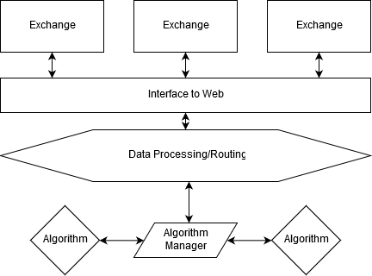
Possible Implementations
Blackbird Bitcoin Arbitrage [C++] (github.com/butor/blackbird)
Gekko: a node.js Bitcoin trading bot (github.com/askmike/gekko)
Golang Bitcoin trading (github.com/philsong/btcrobot)
Or even standalone scripts!

Slide 14
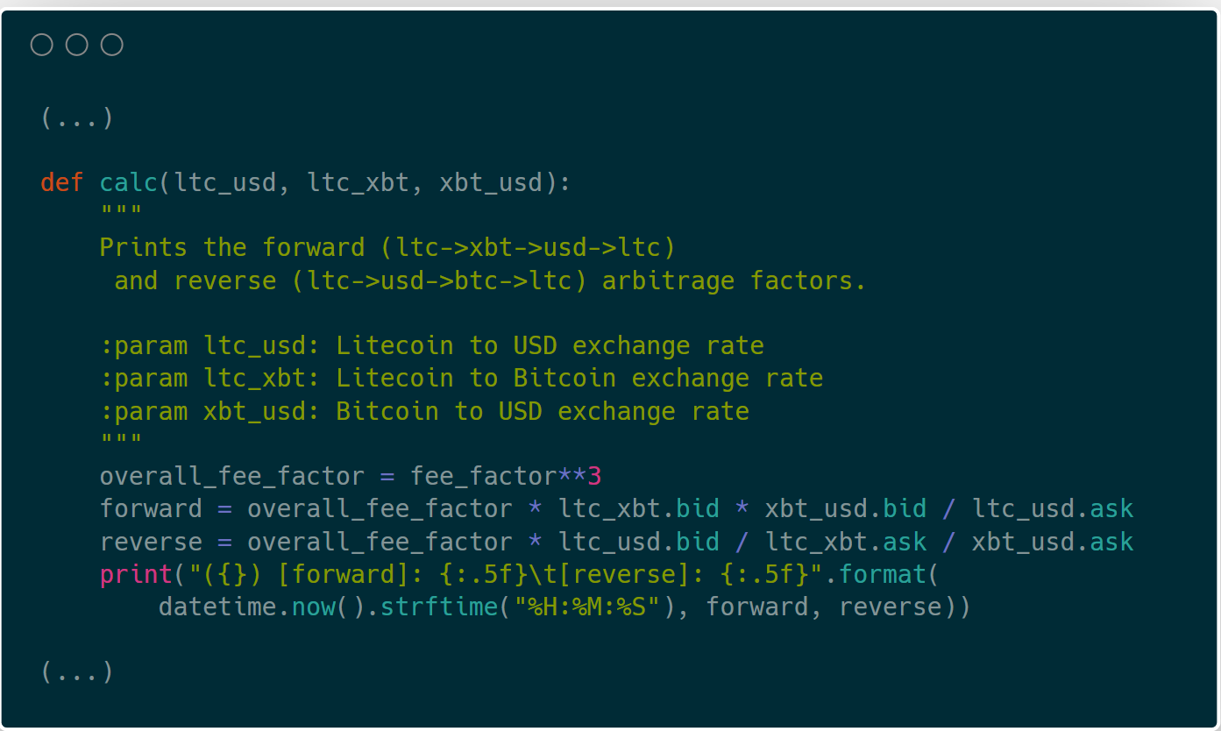
Triangular Arbitrage Example (Demo)

Slide 15
Questions?

